Slide 1
How I made my website gif

Slide 2
A brief history of computers user Interfaces
Back when dinosaurs roamed the earth, and reality was in black a white, there was a room-sized computer and someone was deciding how to talk to it.
They had electronic telegram machines, where you'd type `sos` on a qwerty keyboard and down some wire a signal of ---...--- would be sent, and the other end a machine would read that signal and decode it as 'sos' and print it out on some paper.

Slide 3
A brief history of computers user Interfaces
They took a telegram machine and set it up so you talk to this room-sized computer via telegram.
And then nothing.
NOTHING!

Slide 4
Terminals
Computers still are running as if they were being talked to via telegram, and everyone is maintaining a pile of shit to hide the shame that no one has made a new (successful) OS in decades.

Slide 5
That is what a terminal is, you talking to a computer via telegram; do NOT treat it like magic.

Slide 6
Breaking down the magic Linux-ism line
The first and by far most complicated line of code is
#!/usr/bin/env -S sh -c 'dmd -run gengif.d | convert -size 840x360 -depth 8 rgb:- output.gif'
This one line is 90% of the difficulty of how this project was made and I will be breaking it down slowly

Slide 7
#!
This character combo, at the start of a file, tells a Linux system that this is a script.
And a script, using that very important bit of computer history, is when a computer pretends it sends itself a telegram. Character to character, as if a human wrote it.
It is followed by which "shell" or "telegram listener" it should send the file to.
#!/usr/bin/env -S sh -c 'dmd -run gengif.d | convert -size 840x360 -depth 8 rgb:- output.gif'

Slide 8
/usr/bin/env -S sh -c
I don't know what this actually does and copy and pasted off a website :D
And that’s ok
#!/usr/bin/env -S sh -c 'dmd -run gengif.d | convert -size 840x360 -depth 8 rgb:- output.gif'

Slide 9
dmd -run gengif.d
Dmd is the basic compiler for D and '-run' makes it auto-run, while gengif.d is the name of the file.
#!/usr/bin/env -S sh -c 'dmd -run gengif.d | convert -size 840x360 -depth 8 rgb:- output.gif'

Slide 10
|
A "pipe", is when the output of a program is used *drum roll* as a telegram for another program.
#!/usr/bin/env -S sh -c 'dmd -run gengif.d | convert -size 840x360 -depth 8 rgb:- output.gif'

Slide 11
convert
This is part of the "image magick" toolkit, I believe the part of the tool kit for converting files, maybe. So just imagine a wizard.
#!/usr/bin/env -S sh -c 'dmd -run gengif.d | convert -size 840x360 -depth 8 rgb:- output.gif'

Slide 12
-size 840x360 -depth 8
"expect a image size of 840x360, and 0-255 numbers"
2^8 is 256, so 8x 1 and 0s can be one of 256 states
#!/usr/bin/env -S sh -c 'dmd -run gengif.d | convert -size 840x360 -depth 8 rgb:- output.gif'

Slide 13
rgb:-
The - is magic in Imagemagick for piped input, the rgb: is overloading the data channel format.
So literally, expect 8 bits that mean red, then 8 green, then blue.
All over the ancient telegram lines.
#!/usr/bin/env -S sh -c 'dmd -run gengif.d | convert -size 840x360 -depth 8 rgb:- output.gif'

Slide 14
output.gif
The output; I wonder what file type.
#!/usr/bin/env -S sh -c 'dmd -run gengif.d | convert -size 840x360 -depth 8 rgb:- output.gif'

Slide 15
(you survived!)
Putting it all together, you do that hardest part of all programming, getting a computer to just even remotely consider listening to you.
#!/usr/bin/env -S sh -c 'dmd -run gengif.d | convert -size 840x360 -depth 8 rgb:- output.gif'

Slide 16
Artist rendering of the process:

Slide 17
15-line demo:

Slide 18
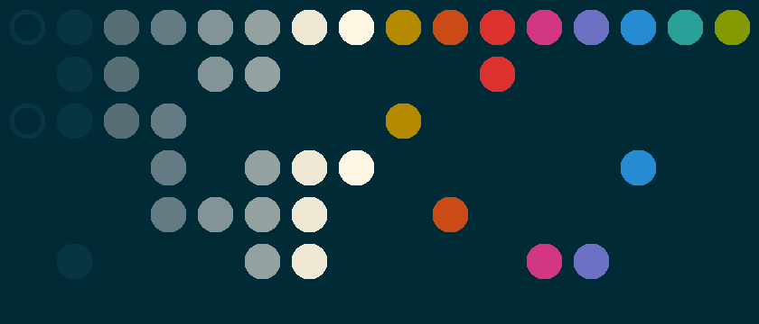
Voronoi diagrams and growing circles
It's a well-known result that growing circles will produce a Voronoi diagram, I'm very much not breaking ground here.

Slide 19
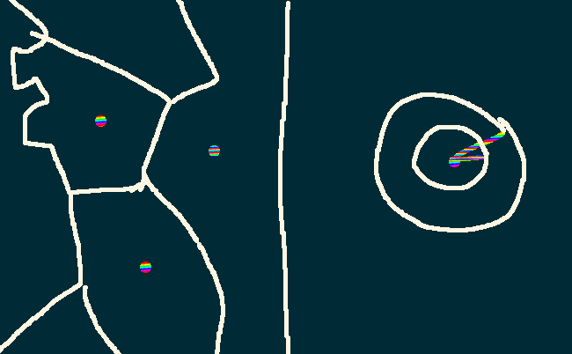
Voronoi diagrams and growing circles
To render a Voronoi diagram (in a terrible way) each pixel asks "What color is my nearest point"
To render a circle (in a terrible way), each pixel asks "How far away from the center am I" and compares it to the radius
To render a "ring" it's the same as the circle but there's a minimum radius

Slide 20
Voronoi diagrams and growing circles
This all quite naturally combines, where I precomputed the color and distance for each pixel, and in each frame, the precomputed result is compared to a global min and max distances.
All I needed to do was keep the min distance quite small for a long time, and well the end seemed boring I added some complexity.

Slide 21
Random circles alone are interesting
Using the same logic a precomputed layer of data of a distance and indexed color, circles that pop in and out are enough to make something worth looking at.

Slide 22
Random circles alone are interesting
Instead of a random color, I grabbed the color from the layer 1 Voronoi diagram to keep it consistent.
=>

Slide 23
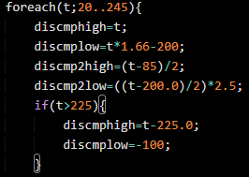
Animation is simple math, with terrible tooling
With those tools in hand, the question becomes, what to set these 4 values?
It was awful trial and error and it's this awful bit of code.

Slide 24
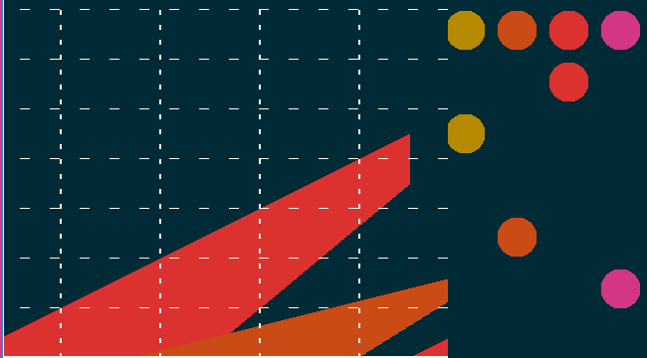
Animation is simple math, with terrible tooling
so here's a helpful graph.
Red is circle growing into a Voronoi diagram orange is the random circles

Slide 25
Optimizing gifs
After that was all said and done, it was still a little lifeless, and 2 megabytes, more than I want to trust will download instantly.
So gifs are a list of pictures and you can just change the timings, so I found the website https://ezgif.com/ and started deleting frames and made some key frames longer, such as the first one; giving your computer time to get a head start to download the image and getting it down to 357.8 kB

